Slide 1
ACT vs SAT: Should standardized tests be required for college entrance?
By: Irene Anibogwu
Friday, July 31st 2020

Slide 2
Objectives:
Compare/contrast the difference in participation rates for students in each state when it comes to taking the ACT and SAT tests
See which states have the highest and lowest participation rates and corresponding test scores
Identify factors influencing participation rates of each test
Make recommendations on what can be done about states with low participation levels in each states or if the tests should be taken

Slide 3
Feature | Type | DataSet | Description
States | Object | SAT/ACT(2017-2018) | States in the U.S that participate in the SAT/ACT
act_participation | float | SAT/ACT(2017-2018) | Participation rates of each state in the U.S
Act_english | float | SAT/ACT(2017-2018) | Avg ACT English scores in each state
Act_science | float | SAT/ACT(2017-2018) | Avg ACT science scores in each state
Act_math | float | SAT/ACT(2017-2018) | Avg ACT math scores in each state
Act_composite | float | SAT/ACT(2017-2018) | Avg of the eng, science, math and reading scores
Sat_participation | float | SAT/ACT(2017-2018) | Participation rates for states in US
ERW | integer | “” | Avg erw in each state
Sat_math | integer | “” | Avg math score in each state
Sat_total | Integer |  | Avg SAT total scores in state

Slide 4
States with the highest participation rates?
ACT 2017
Alabama, Arkansas, Colorado, Kentucky, Louisiana, Minnesota, Mississippi, Missouri, Montana, Nevada, North Carolina, Oklahoma, South Carolina, Tennessee, Utah, Wisconsin, Wyoming are all at 100% participation
SAT 2017
Connecticut, Delaware, DC, Michigan are all at 100% participation
ACT 2018
Wyoming, Tennessee, Oklahoma, Alabama, Kentucky, Louisiana, Mississippi, Nevada, Nebraska, Montana are all at 100% participation
SAT 2018
Colorado, Connecticut, Michigan, Delaware and Idaho are all at 100% participation

Slide 5
States with the highest participation rates?
ACT 2019:
There are 15 states with 100% participation rates are as follows:
Alabama, Arkansas, Kentucky, Louisiana, Mississippi, Montana, Nebraska, Nevada, North Carolina, Ohio, Oklahoma, Tennessee, Utah, Wisconsin, Wyoming
SAT 2019:
8 states had a 100% participation rate in 2019.
They are as follows:
Colorado, Connecticut, Delaware, Florida, Idaho, Illinois, Michigan, Rhode Island

Slide 6
States with the lowest participation rates?
ACT 2017
Maine: 8%
SAT 2017
Mississippi, North Dakota, Iowa: 2%
ACT 2018
Maine: 7%
SAT 2018
Alabama, Arkansas, Iowa, Kansas, Kentucky, Louisiana, Minnesota,
Mississippi, Missouri, Montana, Nebraska, North Dakota, Oklahoma,
South Dakota, Tennessee, Utah, Wisconsin, Wyoming.

Slide 7
States with the lowest participation rates?
ACT 2019
Maine for the 3rd year in a row
SAT 2019
North Dakota

Slide 8
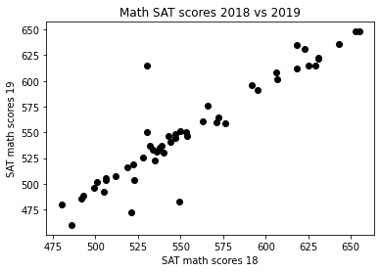

Slide 9
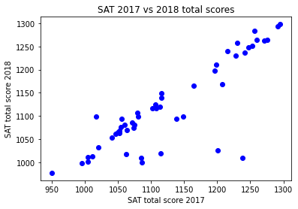
Increase in sat total from 2017-2019 scores?

Slide 10
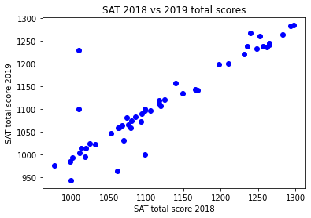

Slide 11
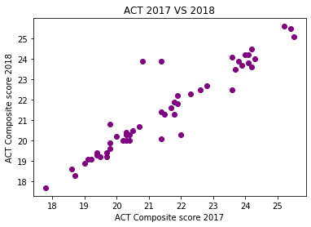
ACT COMPOSITE SCORE 2017 -2019

Slide 12
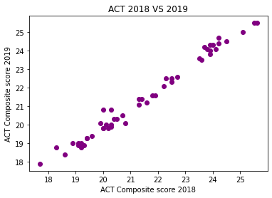

Slide 13
Factors influencing scores
Anxiety
About 2/3 of students suffer from test taking anxiety (https://thenextweb.com/podium/2019/03/16/how-the-act-and-sat-exams-are-built-to-fail-students/)
more on anxiety
https://www.nimh.nih.gov/health/statistics/any-anxiety-disorder.shtml
Family income
Correlation between low income and poor results (No access to tutors, etc)
“stark correlation” between family income and test scores, with lower-income households producing lower-scoring students and vice-versa.
“Some minority groups, including African-American and Latino students, have struggled with the SAT, according to test score data from the College Board”

Slide 14
Recommendations:
Make standardized testing optional or ban in general
Not an accurate representation of a students intelligence or success in college
Measures more of a quantitative rather than qualitative scale. Limiting the quality and diversity of the college student population.

Slide 15
Sources:
https://thenextweb.com/podium/2019/03/16/how-the-act-and-sat-exams-are-built-to-fail-students/
https://www.csmonitor.com/USA/USA-Update/2016/0120/Harvard-study-says-SATs-should-be-optional.-Here-s-why
https://www.oxfordlearning.com/what-is-test-anxiety/#:~:text=Test%20anxiety%20is%20more%20than,test%20anxiety%20at%20any%20age.

